Slide 1
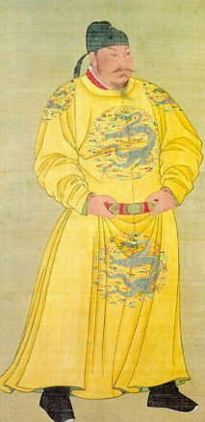
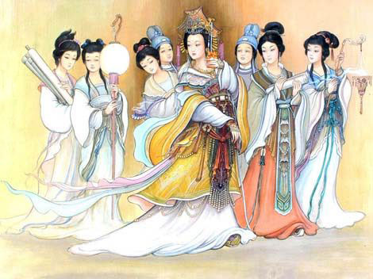
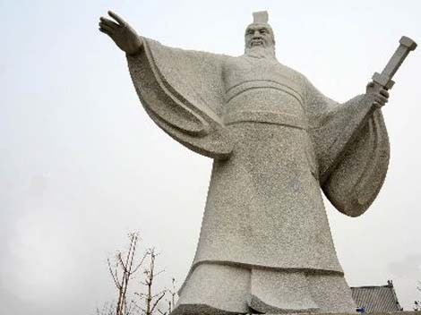
Name: ______________
Due Date: Tuesday, 6/3
Famous Figures
Step 1: Choose ONE character (_______________) you are most interested in to present in class as a dramatic introduction speech, like we saw in A Knight’s Tale.
Step 2: Choose 4 out of the 16 historical characters provided to research, based on your interests. If you want a challenge, choose a few that we didn’t focus on in class.
Step 3: Research. Read the Shanghai Daily newspaper articles and fill out 4 Famous Figures info sheets (one for each character). You may NOT copy what you read, you need to say the information in your own words! You must also work individually on this – no sharing answers!! Finally, you must use at least 2 sources.
Step 4: Create a PPT for the ONE based on your research. You will graded on content, creativity and a 2-5min. presentation. Presentations begin Tuesday!

Slide 2
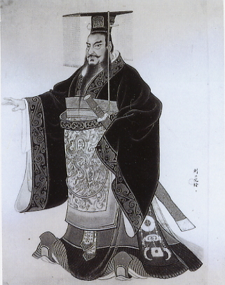
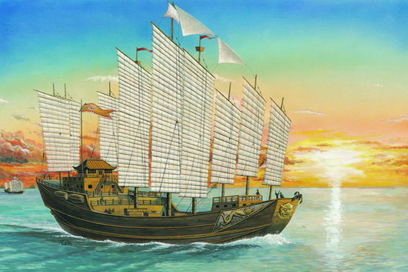
China’s Hall of Fame
We know…
Qin Shi Huang
Liu Bang
Emperor Wu of Han
Cao Cao
Taizong (Li Shimin)
Empress Wu Zetian (Wu Zhao)
Zheng He
Da Yu (Yu the Great)
Shang Yang (reformer – meritocracy)
Less Familiar…
- Zhuge Liang
- Granny Huang (Huang Daopo)
- Zhan Tianyou (railroads)
- Yellow Emperor
- Qi Jiguang the “Tiger General”
- Yue Fei (general)
- Wen Tianxiang (hero)

