Slide 1
JEOPARDY!
Click Once to Begin
Social Studies Edition

Slide 2
JEOPARDY!
6 Themes
The First Emperor
Dragons
Ancient China
China - Geography
Dynasties
100
100
100
100
100
100
200
200
200
200
200
200
300
300
300
300
300
300
400
400
400
400
400
400
500
500
500
500
500
500

Slide 3
Daily Double Graphic and Sound Effect!
Daily Double!!!
DO NOT DELETE THIS SLIDE! Deleting it may cause the game links to work improperly. This slide is hidden during the game, and WILL not appear.
In slide view mode, copy the above (red) graphic (click once to select; right click the border and choose “copy”).
Locate the answer slide which you want to be the daily double
Right-click and choose “paste”. If necessary, reposition the graphic so that it does not cover the answer text.

Slide 4
1/100 – Identify this theme: The way of life shared by a group of people

Slide 5
1/200 – Identify this theme: The system of laws and authority that a society uses to control its members

Slide 6
1/300 - Identify this theme: improving methods of doing things

Slide 7
1/400 - Identify this theme: The way that people respond to and/or are affected by their envirnonment

Slide 8
1/500 – Which theme best describes what you’ve learned about oracle bones and why they’re important to the Shang? Why?

Slide 9
2/100 – Why did Shihuangdi build the first Great Wall of China?

Slide 10
2/200 – What was the purpose of the terra cotta warriors?

Slide 11
2/300 – Why was Shihuangdi known for being a cruel ruler? Give 3 specific examples.
Daily Double!!!

Slide 12
2/400 – Did China’s First Emperor leave a positive or negative legacy? Give 3 specific details to support your answer.

Slide 13
2/500 – What problem did The First Emperor face when he took power? What was his solution? Give 3 specific details.

Slide 14
3/100: What kind of ears does a dragon have?

Slide 15
3/200 – What did the ancient Chinese believe the purpose of dragons were?

Slide 16
3/300 – What was the original purpose of the Chinese New Year Festival? And what is special about the Year of the Dragon?

Slide 17
3/400 – Give 2 comparisons and 2 contrasts between Chinese and Western Dragons

Slide 18
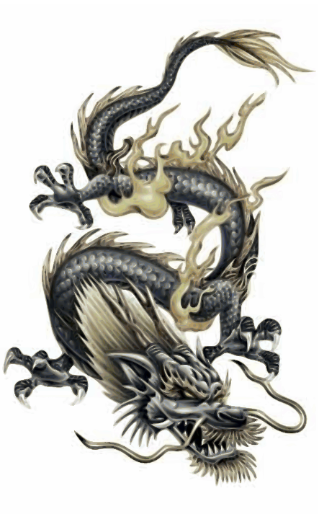
3/500 – Name all of the animal parts that make up a dragon Bonus (100): Name the evil dragon from The Hobbit

Slide 19
4/100 – What were the farmers, hunters and nomads fighting for?

Slide 20
4/200 – What is the name often given to a sequence of rulers from a powerful family?

Slide 21
4/300 – Why did the Ancient Chinese call their land “The Middle Kingdom”?

Slide 22
4/400 – What is the first dynasty that we have significant historical evidence for? How was it first discovered?

Slide 23
4/500 – Draw a picture of Yin and Yang and explain what each represent. Also, what does the symbol of yin and yang represent for Daoism?

Slide 24
5/100 – Name the two major rivers that run through China

Slide 25
5/200 – What is the name of the valley where crops were first grown around 7,000BC?

Slide 26
5/300 – Describe how different climates in China create the best conditions for different types of crops.

Slide 27
5/400 Name 2 natural features that give China isolated valleys. How does this help early Chinese civ.?
Daily Double!!!

Slide 28
5/500 - Name and describe how 3 major geographical features affected the development of early Chinese civilization.

Slide 29
6/100 – Who is Shangdi?

Slide 30
6/200 - List and describe two different reasons why bronze is important for the Shang Dynasty

Slide 31
6/300 – Name 3 accomplishments of the Zhou dynasty

Slide 32
6/400 - Explain the 6 steps of the dynastic cycle: be sure to define the Mandate of Heaven in your answer.

Slide 33
Answer 6/500 – Which state was victorious during the Warring States Period? What 2 things allowed them to win?

