Slide 1
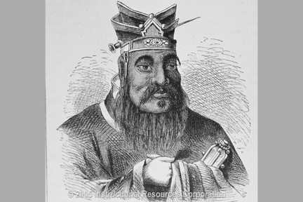
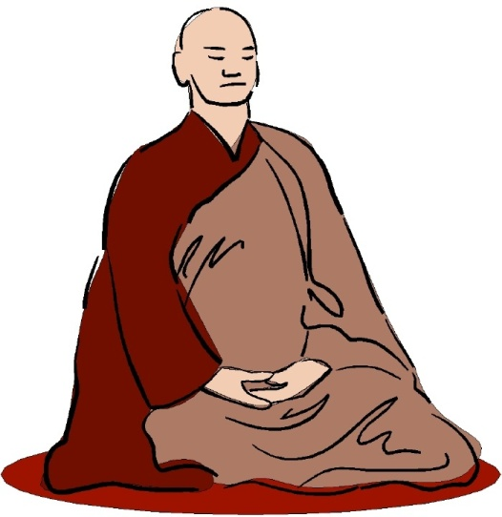
Confucianism vs Buddhism
Compare & Contrast
In 2 separate paragraphs…
How is Buddhism different from Confucianism? Show at least 2 ways that their ideas contrast.
How are they similar? In what ways do they complement each other? Why do many Chinese believe that they can practice both?

