Slide 1
Five Dynasties and ten kingdoms
907-960AD
It’s time for CHAOS…again.

Slide 2
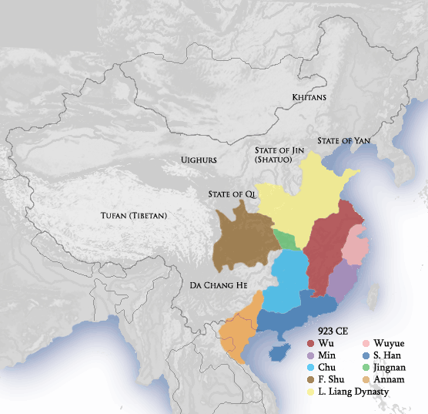
Jiedushi
Military governors rebel!
5 Dynasties change rapidly in north
10 Kingdoms fight for power in south

Slide 3
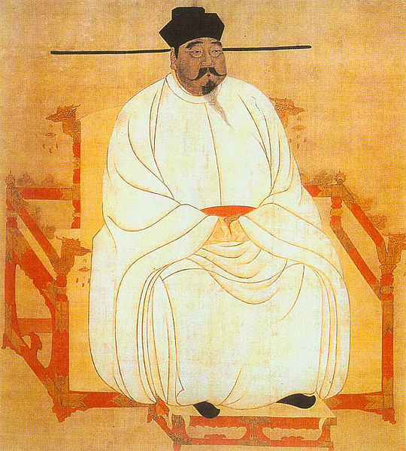
Emperor Taizu
Unifies China, beginning the Song Dynasty, 960 AD

Slide 4
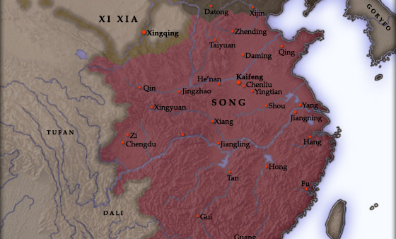
Song Dynasty
Capital
City:
Kaifeng
960-1279 AD

Slide 5
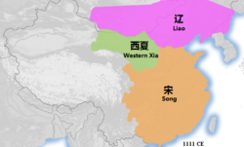
Liao Dynasty (907-1125) = Khitan Empire
China’s powerful
Northern
neighbors
W. Xia (1038-1227) = Tangut Empire

Slide 6
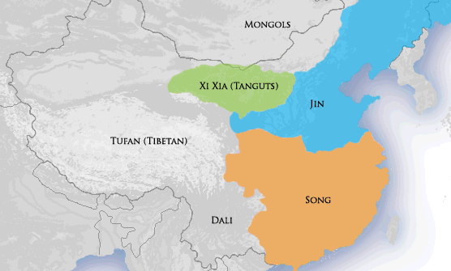
Jin(n) Dynasty = Jurchen
Defeat Liao Dynasty
& betray
Hui Zong
1115 - 1234 AD

Slide 7
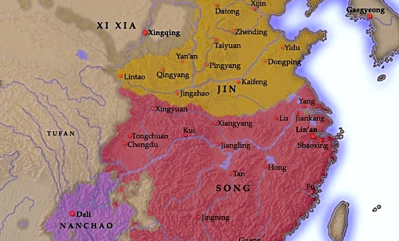
Southern Song Dynasty
Capital
City:
Lin’an
(a.k.a. Hangzhou)
1127-1279 AD

Slide 8
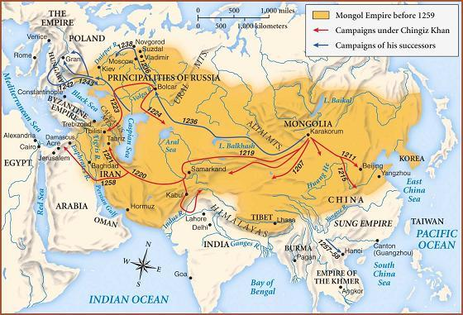
Mongol Empire Before 1259

Slide 9
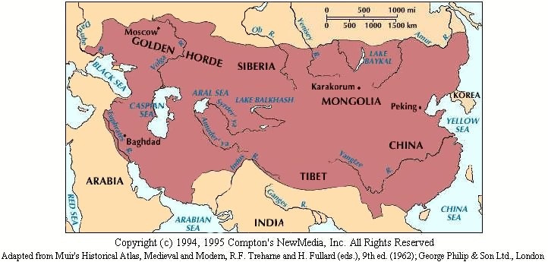
Mongol Empire is Biggest Ever!

