Slide 1
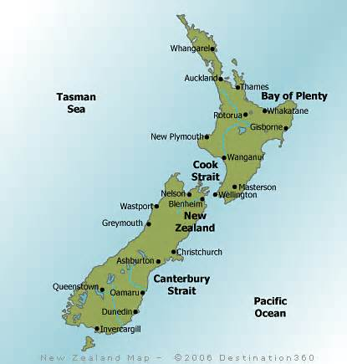
International Day!
Names: ______________
Due Date: Tues., 5/20
Step 1: Choose a topic from your HR country and work in groups of two. Our topic is ______________________.
Step 2: Research. Use AT LEAST 2 different sources. These can be books, websites, etc. Write this information IN YOUR OWN WORDS. → 2b: You must create a “Works Cited” page
Step 3: Answer the essential questions about your invention (provided on the following page).
Step 4: Create a PPT AND a Poster (and other visual aids if you like ☺) based on your research. You will graded on content, creativity and a 2-5min. presentation. Remember, this is your opportunity to demonstrate your knowledge to both to your classmates AND to the rest of the world that will be coming to International Day!
Presentations begin Tuesday!

Slide 2
The Essential Questions
Answer the following in complete sentences, using specific details for support.
Explain your topic in detail: What is it? Why is it important to New Zealand? Summarize your most important info here:
2. If a tourist were to visit New Zealand today, where, when & how would that person experience your topic?
_______________________________________________________________________________________________________________________________________________________________________________________________________________________________________
3. Record AT LEAST two other interesting facts about your topic:
1.____________________________________________________________________________________________________________________
2.____________________________________________________________________________________________________________________
______________________________________________________________________________________________________________________________ ______________________________________________________________________________________________________________________________ ______________________________________________________________________________________________________________________________ ______________________________________________________________________________________________________________________________ ______________________________________________________________________________________________________________________________ ______________________________________________________________________________________________________________________________ ______________________________________________________________________________________________________________________________ ______________________________________________________________________________________________________________________________ ______________________________________________________________________________________________________________________________
Score:____ /50

