Slide 1
JEOPARDY!
Click Once to Begin
Social Studies Edition

Slide 2
JEOPARDY!
Types of
Maps
Map Components
Map Skills
Time Zones
China & World
Zones of China
100
100
100
100
100
100
200
200
200
200
200
200
300
300
300
300
300
300
400
400
400
400
400
400
500
500
500
500
500
500

Slide 3
Daily Double Graphic and Sound Effect!
Daily Double!!!
DO NOT DELETE THIS SLIDE! Deleting it may cause the game links to work improperly. This slide is hidden during the game, and WILL not appear.
In slide view mode, copy the above (red) graphic (click once to select; right click the border and choose “copy”).
Locate the answer slide which you want to be the daily double
Right-click and choose “paste”. If necessary, reposition the graphic so that it does not cover the answer text.

Slide 4
1/100 – I am not known for my man-made features, but you will find natural, physical features on my type of map.

Slide 5
1/200 – This type of map shows how humans have impacted the landscape.

Slide 6
1/300 – Look at this type of map if you want to focus on one piece of information

Slide 7
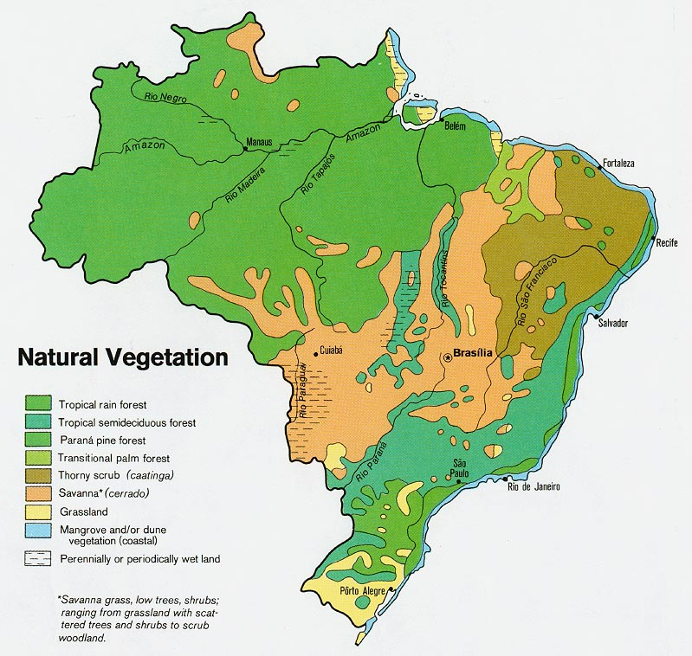
1/400- Identify this Map
Why?

Slide 8
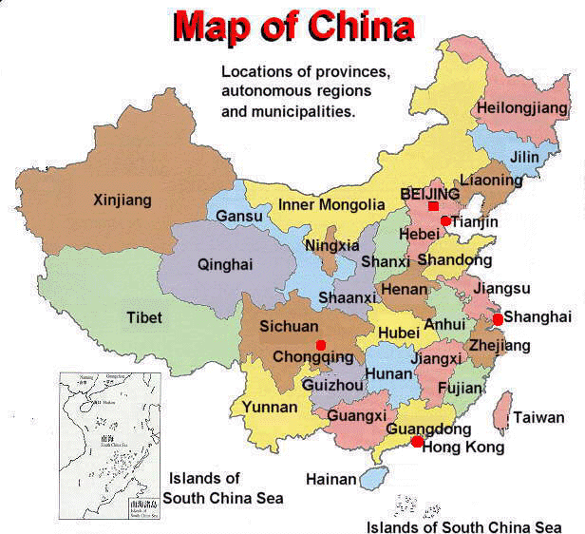
1/500- Identify this Map
Why?

Slide 9
2/100 – This part of the map tells you what the map is all about!

Slide 10
2/200 – This part of the map explains the map’s colors and symbols

Slide 11
2/300 – This part of the map allows you to find specific locations, using latitude and longitude lines

Slide 12
2/400 – This part of the map shows the relationship between the distance on the map and the distance on the Earth’s surface.

Slide 13
2/500 – Draw a compass rose and label the 4 cardinal directions as well as the 4 intermediate directions

Slide 14
3/100 – What are the two most important imaginary lines on the world grid?

Slide 15
3/200 – What famous city in England does the Prime Meridian run through? What year was the Prime Meridian created?

Slide 16
3/300 – The map scale tells you 1cm = 600km. Shanghai is 20 cm away from Washington DC. How Far is Shanghai from Washington DC?

Slide 17
3/400 – What are the Latitude and Longitude coordinates of Point #1?

Slide 18
3/500 - What are the Latitude and Longitude coordinates of Point #3?

Slide 19
4/100 – How many time zones does China have?

Slide 20
4/200 – How does the Int’l Date Line work? At about how many degrees of longitude is it located?

Slide 21
4/300 – Time zones generally change every ___ degrees of longitude. If you were traveling two time zones to the west…______?

Slide 22
4/400 – Why do we have time zones? (2 part answer)

Slide 23
4/500 – You want to call your friend in Los Angeles, CA, but there is a 15-hr time difference. If it is 11am on Wednesday here, what time/day is it there?

Slide 24
5/100 – Locate Shanghai.

Slide 25
5/200 – Locate Hong Kong & Macau (which one is which? ☺)

Slide 26
5/300 – Name the four hemispheres. Which hemisphere has its summer from December – February?

Slide 27
5/400 – Locate Hebei, Henan, Hubei and Hunan on the map of China.

Slide 28
5/500 – Name and Locate all of the world continents and oceans.
Daily Double!!!

Slide 29
6/100 – A province is similar to a _______.

Slide 30
6/200 – Beijing is an example of a ________. Define this type of zone.

Slide 31
6/300 – What is special about the autonomous regions of China?

Slide 32
6/400 – What does SAR stand for? Which foreign countries used to control Hong Kong and Macau?

Slide 33
6/500 – Name all 5 Autonomous Regions of China.

